Slide 1
Tutorial Week 4
By Coulouris, Dollimore and Kindberg,

Slide 2

Question 1
Rule VC2 (p. 399) tells us that $P_{i}$is the ‘source’ of increments to $V_{i}[i]$, which it makes just before it sends each message; and that $P_{j}$ increments $V_{j}[i]$ only as it receives messages containing timestamps with larger entries for $P_{i}$. The relationship $V_{j}[i]≤V_{i}[i]$follows immediately.

Slide 3
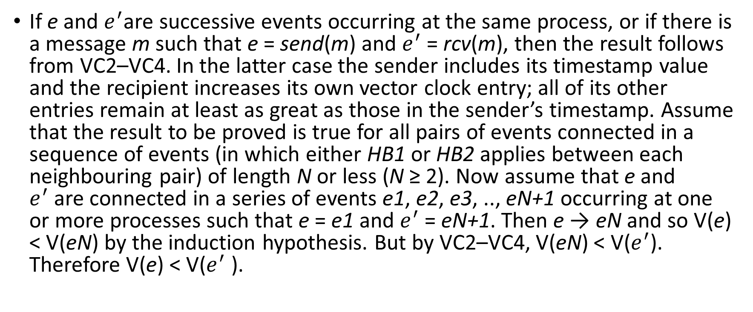
Question 2
If e and $e^{′}$are successive events occurring at the same process, or if there is a message m such that e = send(m) and $e^{′}$= rcv(m), then the result follows from VC2–VC4. In the latter case the sender includes its timestamp value and the recipient increases its own vector clock entry; all of its other entries remain at least as great as those in the sender’s timestamp. Assume that the result to be proved is true for all pairs of events connected in a sequence of events (in which either HB1 or HB2 applies between each neighbouring pair) of length N or less (N ≥ 2). Now assume that e and $e^{′}$are connected in a series of events e1, e2, e3, .., eN+1 occurring at one or more processes such that e = e1 and $e^{′}$= eN+1. Then e → eN and so V(e) < V(eN) by the induction hypothesis. But by VC2–VC4, V(eN) < V($e^{′}$). Therefore V(e) < V($e^{′}$ ).

Slide 4
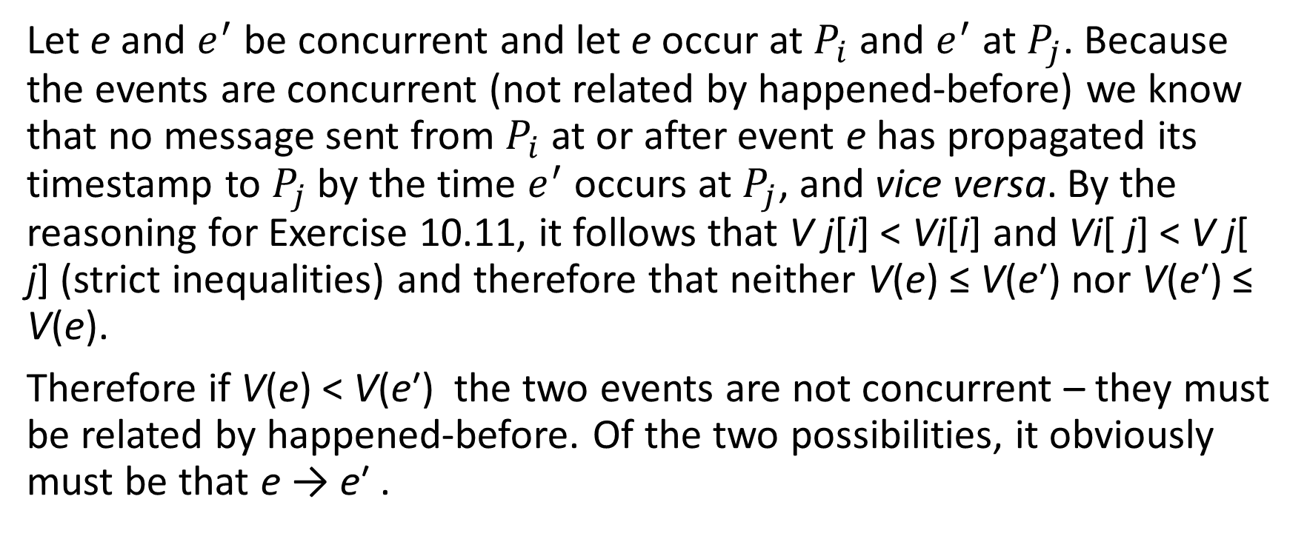
Question 3
Let e and $e^{′}$ be concurrent and let e occur at $P_{i}$ and $e^{′}$ at $P_{j}$. Because the events are concurrent (not related by happened-before) we know that no message sent from $P_{i}$ at or after event e has propagated its timestamp to $P_{j}$by the time $e^{′}$ occurs at $P_{j}$, and vice versa. By the reasoning for Exercise 10.11, it follows that V j[i] < Vi[i] and Vi[ j] < V j[ j] (strict inequalities) and therefore that neither V(e) ≤ V(e′) nor V(e′) ≤ V(e).
Therefore if V(e) < V(e′) the two events are not concurrent – they must be related by happened-before. Of the two possibilities, it obviously must be that e → e′ .

